Slide 1

The Brain
An interactive database full of the guts and gore of zombie movies through the decades.
Brought to you by: Gil, Lyndsi and Tyler

Slide 2


The Concept
White Zombie, directed by Victor Halperin is commonly cited as the first Zombie movie and released in 1932
What kind of trends have emerged through the years since then?

Slide 3
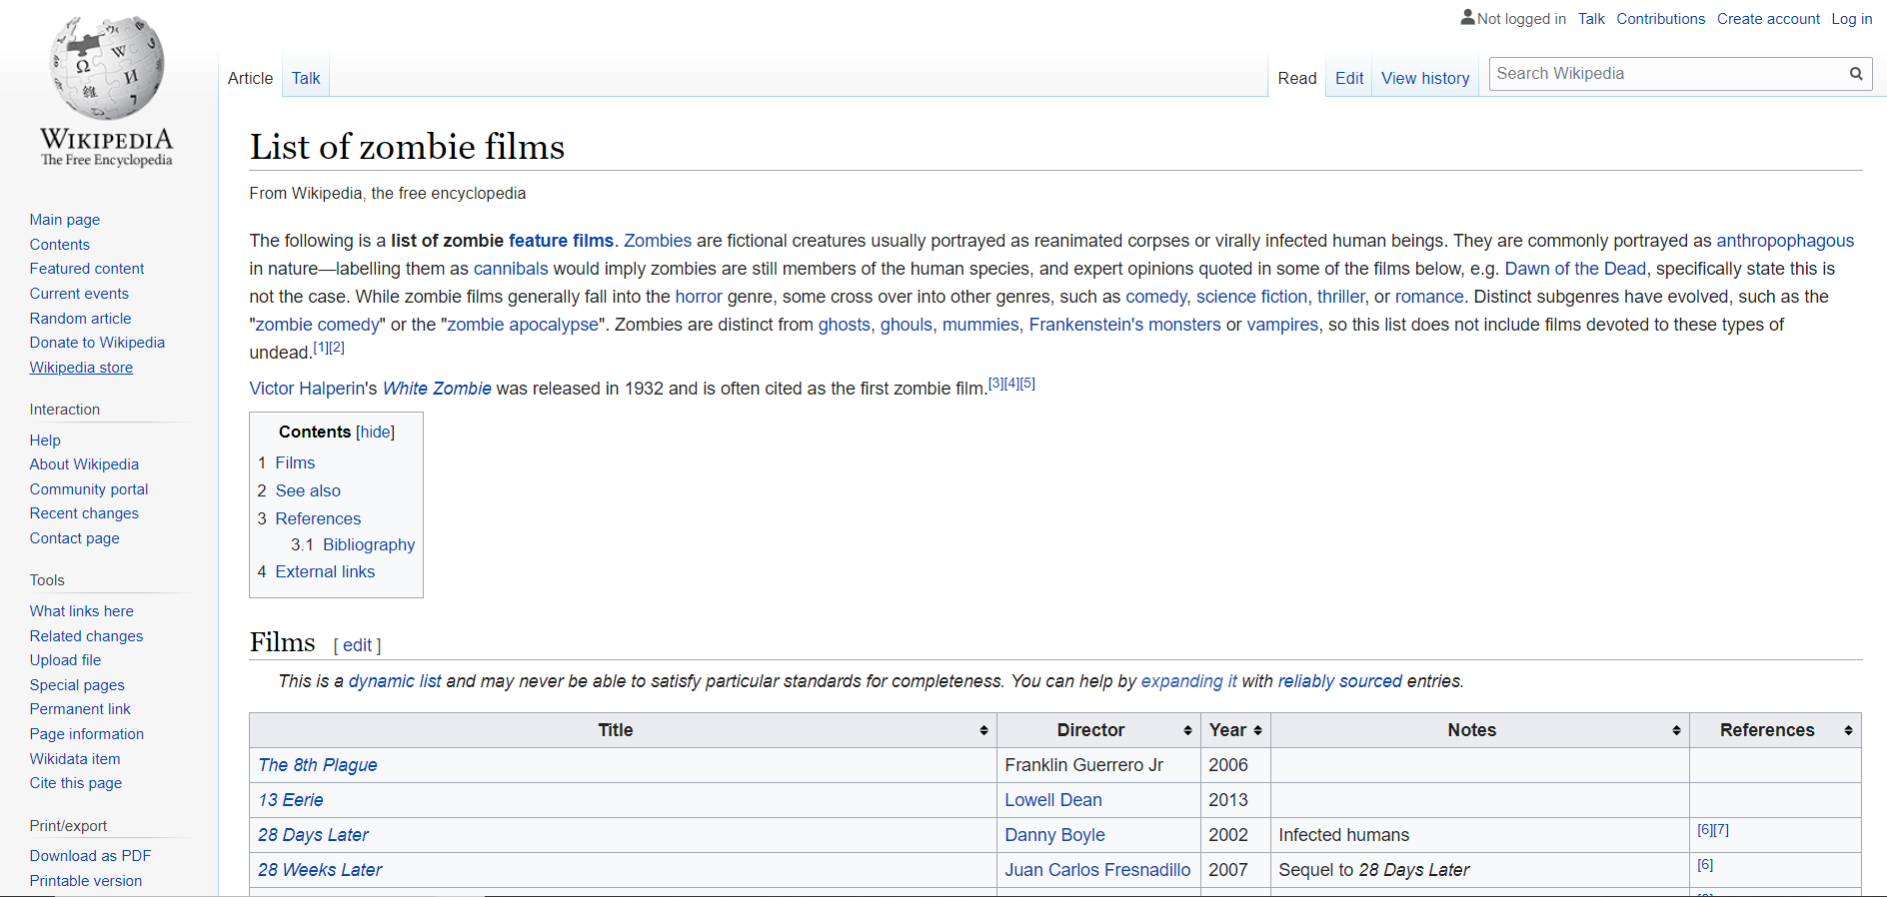
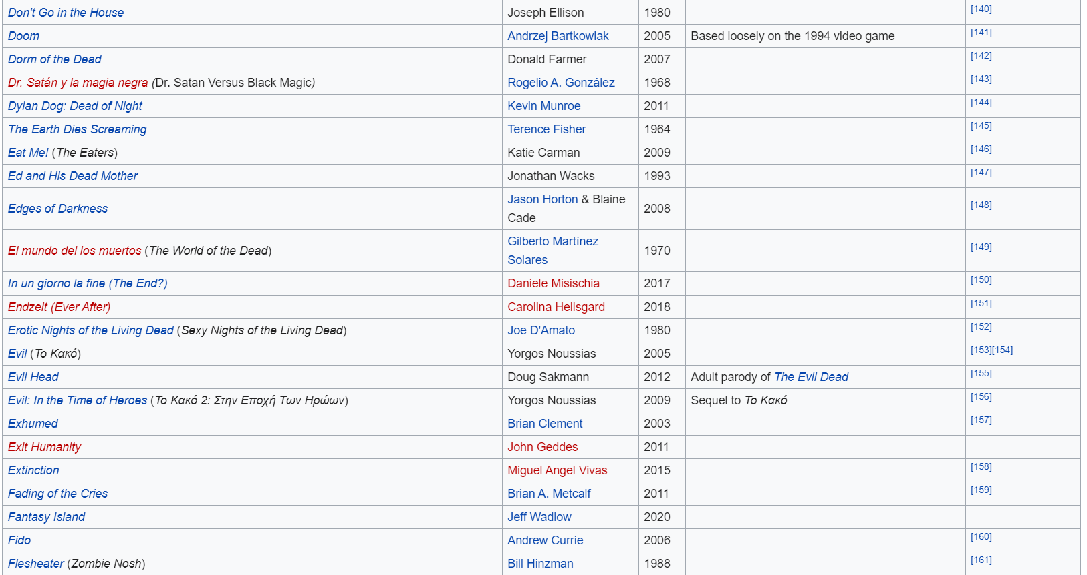
The Source
549 Zombie films on Wikipedia’s “List of Zombie Films” page

Slide 4
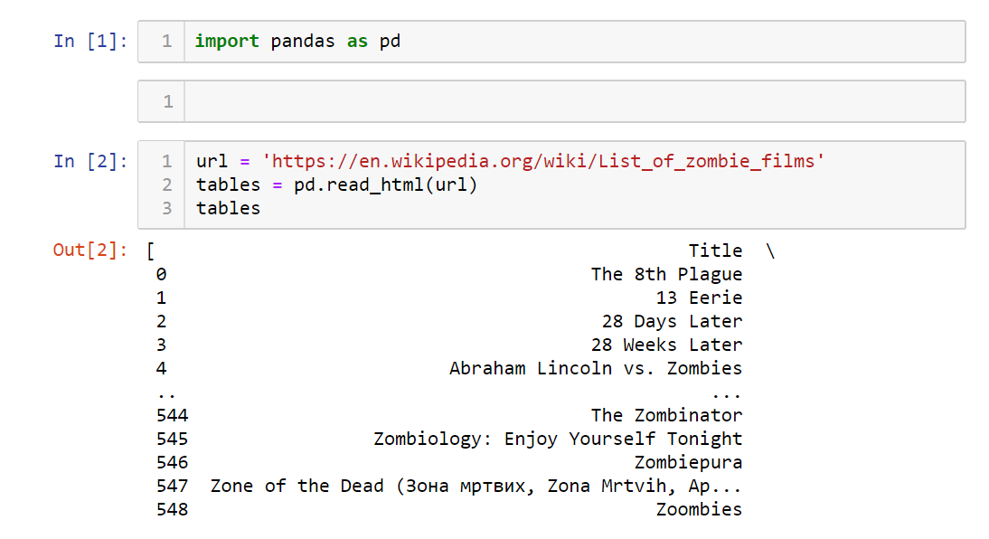
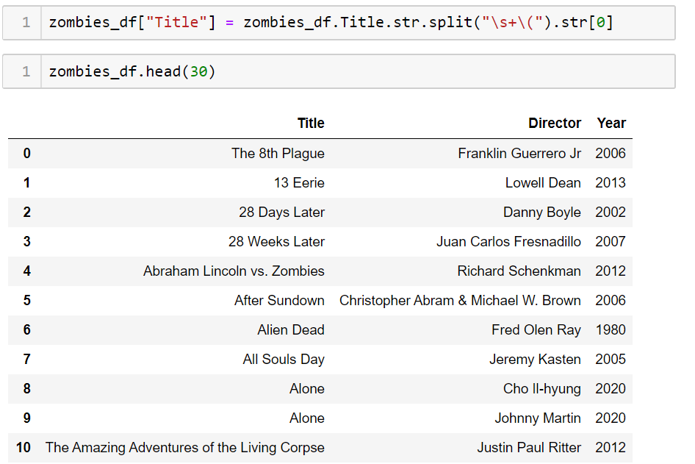
The Scrape
The Clean
The CSV

Slide 5
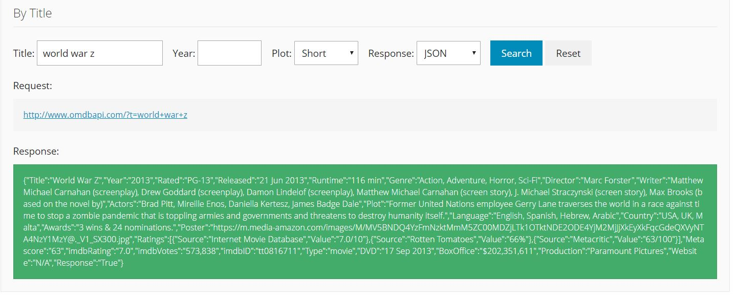
Running through OMDB

Slide 6
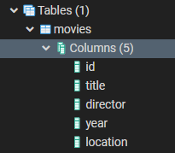

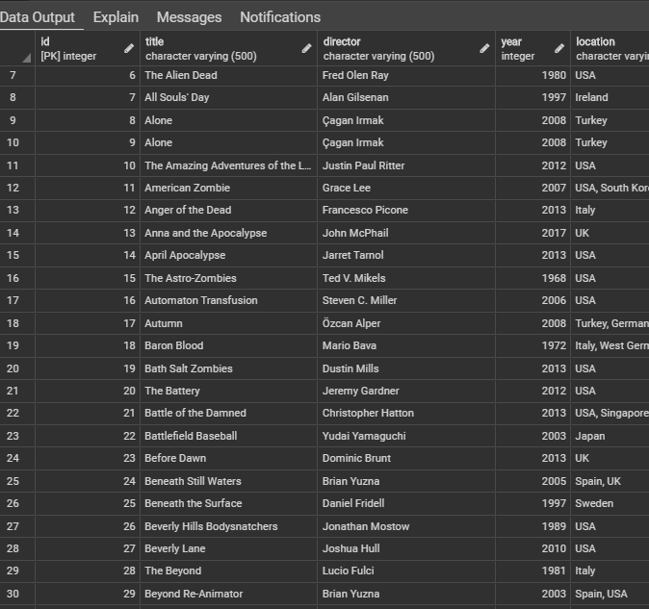
The Database

Slide 7
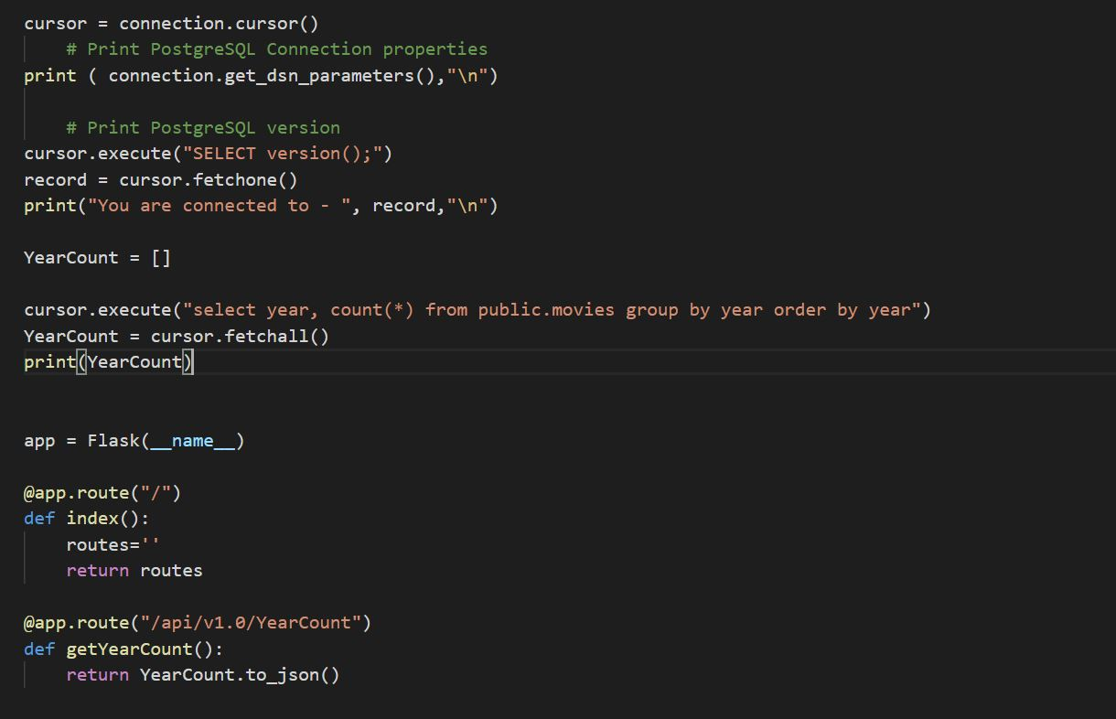
The App: Postgres-> Flask with templates & endpoints ->Javascript->Plotly->HTML

Slide 8

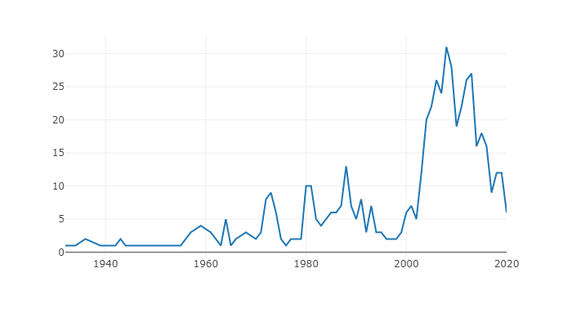
The Graphs

Slide 9
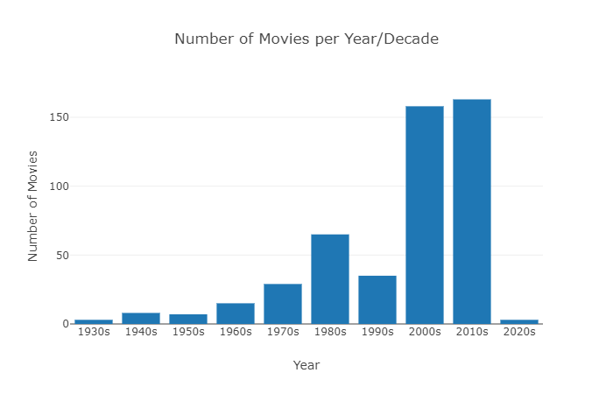
The Graphs

Slide 10
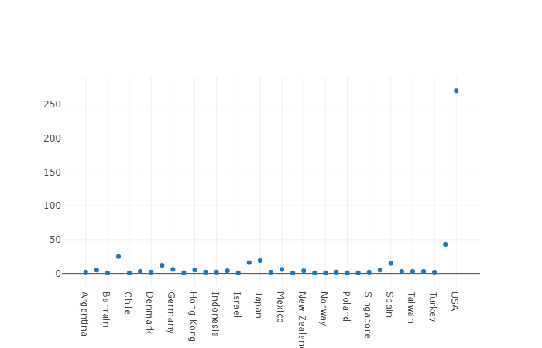
The Graphs

Slide 11

The Site

